Slide 1
Dual H-Bridge
L298N Breakout Board
By Marcelo Moraes
BIGDOG1971

Slide 2

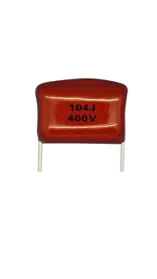
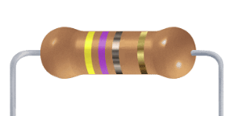
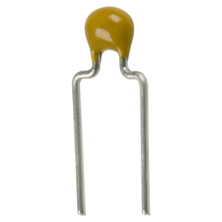
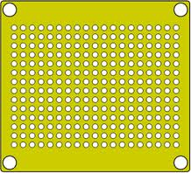
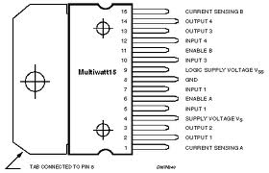
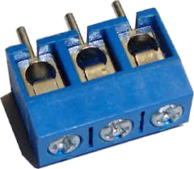
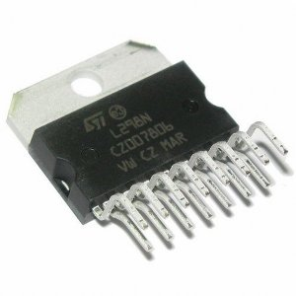
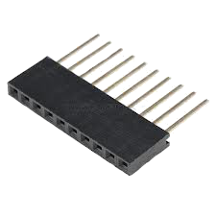
Components
A
K
1 x perf board 13x26 holes (3,5 x 7,0 cm)
2 x AK300/3 connector
1 x 8 Header female connector for Arduino
1 x L298N (Multiwatt15)
8 x 1N4001 Diode
2 x 100nF capacitor
2 x 0,47Ohm x 1W Resistor
Wire (green and blue colors)

Slide 3
Perf Circuit Board - Prototype
Upper view
pad with single separation
pad with triple separation
GND
Common GND
O4
Input 4
Input 3
O3
Enable B
Enable A
O2
Input 2
Input 1
O1
VCC +5V
VS
+12V
To Arduino
To DC Motors
or Step Motor
Pad with double separation

Slide 4
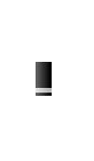
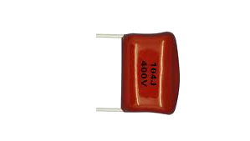

Components layout
Upper view
GND
Common GND
O4
104
Input 4
Input 3
O3
Enable B
Enable A
O2
Input 2
Input 1
O1
VCC +5V
104
VS
+12V
To Arduino
To DC Motors
or Step Motor

Slide 5
Soldering Tracks
Upper view
GND
Common GND
O4
Input 4
Input 3
O3
Enable B
Enable A
O2
Input 2
Input 1
O1
VCC +5V
VS
+12V
To Arduino
To DC Motors
or Step Motor
Soldered tracks in red color,
on the botton layer of the circuit board

Slide 6
Wired Tracks
Upper view
GND
Common GND
O4
Input 4
Input 3
O3
Enable B
Enable A
O2
Input 2
Input 1
O1
VCC +5V
VS
+12V
To Arduino
To DC Motors
or Step Motor
Green wire – on the upper layer
Blue wire – on the botton layer

Slide 7
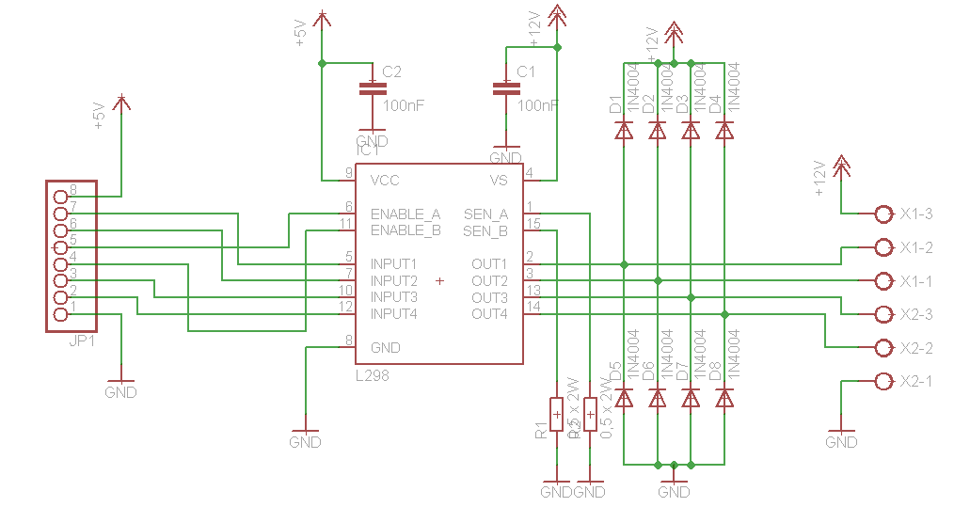
Schematic

Slide 8
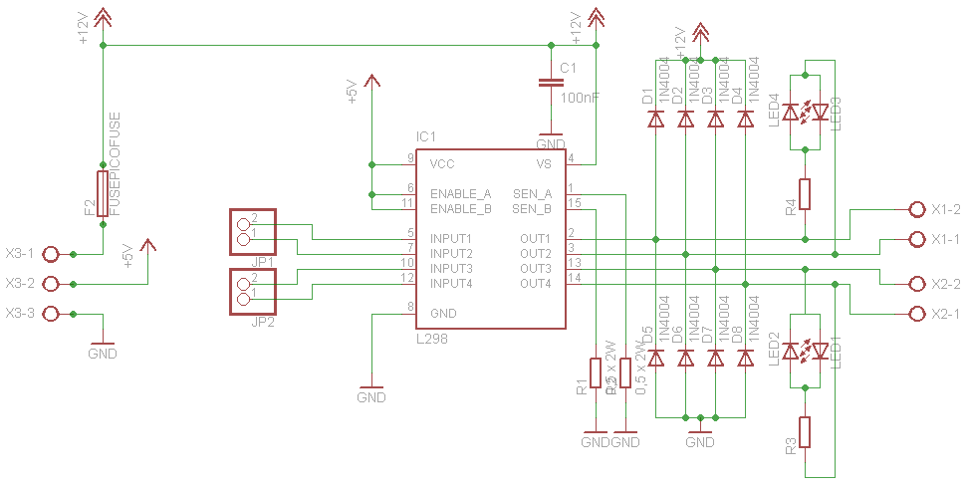
A more complet version

Slide 9
